Slide 1
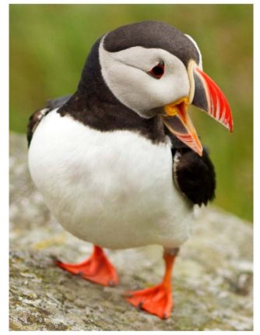
Bird Colors

Slide 2
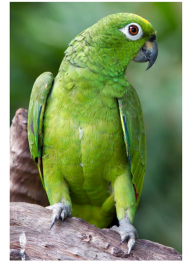

This bird is green.

Slide 3
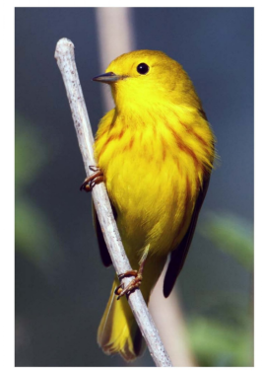

This bird is yellow.

Slide 4
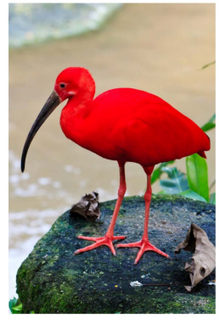

This bird is red.

Slide 5
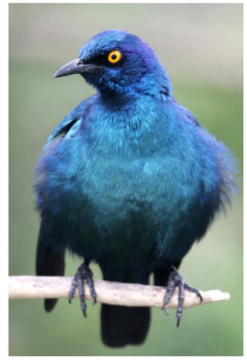

This bird is blue.

Slide 6
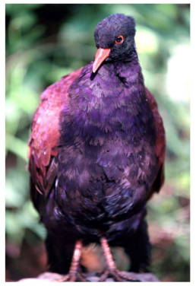

This bird is purple.

Slide 7
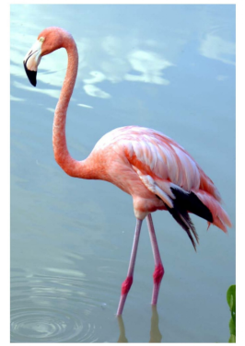

This bird is pink.

Slide 8
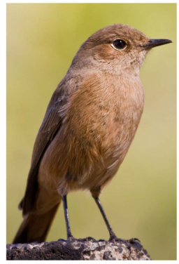

This bird is brown.

Slide 9
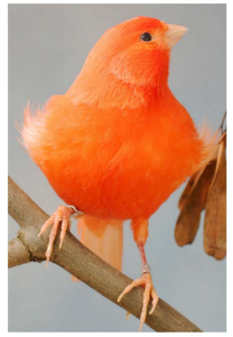

This bird is orange.

Slide 10
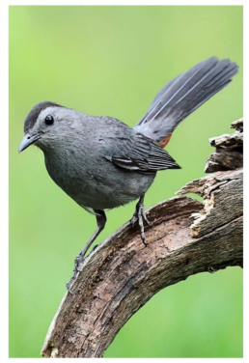

This bird is gray.

Slide 11
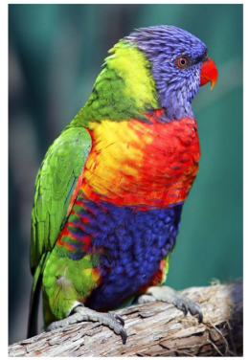

This bird is many colors.

Slide 12










Q:What colors are they?
Click on the “ ” to find the answer!

Slide 13
This bird is green.
Return

Slide 14
This bird is yellow.
Return

Slide 15
This bird is red.
Return

Slide 16
This bird is blue.
Return

Slide 17
This bird is purple.
Return

Slide 18
This bird is pink.
Return

Slide 19
This bird is brown.
Return

Slide 20
This bird is orange.
Return

Slide 21
This bird is gray.
Return

Slide 22
This bird is many colors.
Return

